Slide 1
OPERATING SYSTEMS

Slide 2
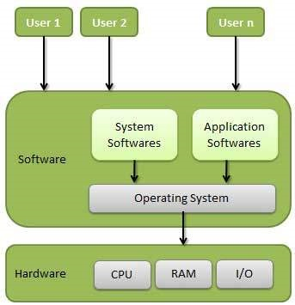
Operating System - Definition
An operating system is a program that acts as an interface between the user and the computer hardware and controls the execution of all kinds of programs.
An operating system (OS) is system software that manages computer hardware, software resources, and provides common services for computer programs.
E.g.
Microsoft Windows
Linux
iOS
Android etc.

Slide 3
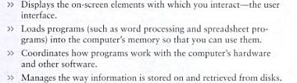
Operating Systems – Basic Functions
Beside above mentioned operating system performs all the basic tasks like;
file management
memory management
process management
handling input and output
controlling peripheral devices such as disk drives and printers.

Slide 4
Types of Operating System
Real Time Operating System:
A real-time system is defined as a data processing system in which the time interval required to process and respond to inputs is so small that it controls the environment.
A real-time operating system must have well-defined, fixed time constraints, otherwise the system will fail. For example, Scientific experiments, medical imaging systems, industrial control systems, weapon systems, robots, air traffic control systems, etc.

Slide 5
Types of Operating System
Single User Operating System:
An operating system that allows a single user to perform only one task or multiple tasks at a time is called a Single-User Operating System. Functions like printing a document, downloading images, etc., can be performed only one at a time.
Examples include MS-DOS, Palm OS, etc.

Slide 6
Types of Operating System
Multi user Operating System
A multi user operating system allows to permission of multiple users for accessing the single machine at a time. All different users can access that system running operating system with the help of several terminals, which are connected in networking form

Slide 7
Types of Operating System
Time-sharing operating system
Time-sharing is a technique which enables many people, located at various terminals, to use a particular computer system at the same time.
Processor's time which is shared among multiple users simultaneously is termed as time-sharing.

Slide 8
Types of Operating System
Distributed operating System
Distributed systems use multiple central processors to serve multiple real-time applications and multiple users.
Data processing jobs are distributed among the processors accordingly.

Slide 9
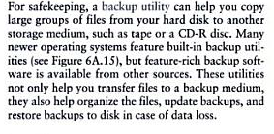
Enhancing OS with Software Utilities.
Backup Utilities:

Slide 10
Enhancing OS with Software Utilities.
Antivirus:

Slide 11
Enhancing OS with Software Utilities.
Firewalls:
In computing, a firewall is a network security system that monitors and controls incoming and outgoing network traffic based on predetermined security rules. A firewall typically establishes a barrier between a trusted internal network and un-trusted external network, such as the Internet.

Slide 12
Enhancing OS with Software Utilities.
Screensavers:
A screensaver (or screen saver) is a computer program that blanks the screen or fills it with moving images or patterns when the computer has been idle for a long time. The original purpose of screensavers was to prevent phosphor burn-in on CRT and plasma computer monitors (hence the name).
Though modern monitors are not susceptible to this issue, screensavers are still used for other purposes.
Screensavers are often set up to offer a basic layer of security, by requiring a password to re-access the device.

Slide 13
THE END

